Slide 1

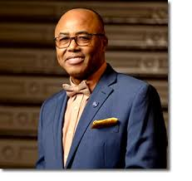
District 28
CEC Presentation
Superintendent: Dr. Eric L. Blake
Date: Thursday, May 6, 2026

Slide 2
District 28 Mission and Vision
Mission:
In Community School District 28 we focus on equity as a lever for achievement for every single scholar. We are a district of excellence. We commit to every school maintaining high academic standards and working closely with families so that all scholars are learning at high levels. Beginning with school leaders, teachers, students and community partners, we also commit to being a district of learners ensuring that we promote critical thinking rooted in core content conceptual understanding through creative problem solving, technology innovation, social emotional learning and community advocacy.
Vision:
In Community School District 28 we celebrate our differences because we understand that woven into those differences is the knowledge that they offer us unlimited possibility to learn and expand our knowledge of and commitment to all humanity. We are beautifully diverse, varied; coming from countless racial, ethnic, language, and belief backgrounds. We commit to striving for inestimable contribution to the lives of our scholars.

Slide 3
D28 Superintendent Priorities
Improve outcomes in Mathematics by implementing a common research-based curriculum and introducing or scaling, where appropriate, Regents level courses for scholars
01
Improve literacy skills by implementing research-based, Science of Reading (SOR) HMH curriculum in all K-8 schools.
02
Work to substantially improve daily attendance and reduce chronic absenteeism.
03
Continue to increase Parent and Family Engagement and Community Partnerships.
04

Slide 4
D28- District Non-Negotiables
Standards-Aligned Instruction: All lessons must be aligned to grade-level standards and learning objectives.
Small Group Instruction
Explicit Teaching with Gradual Release: Teachers model, guide, and then release responsibility for independent practice.
Active Student Engagement: Students are consistently engaged through questioning, discussion, and checks for understanding.
Data-Driven Differentiation: Instruction is adjusted based on formative assessment to meet diverse student needs within the core lesson.

Slide 5
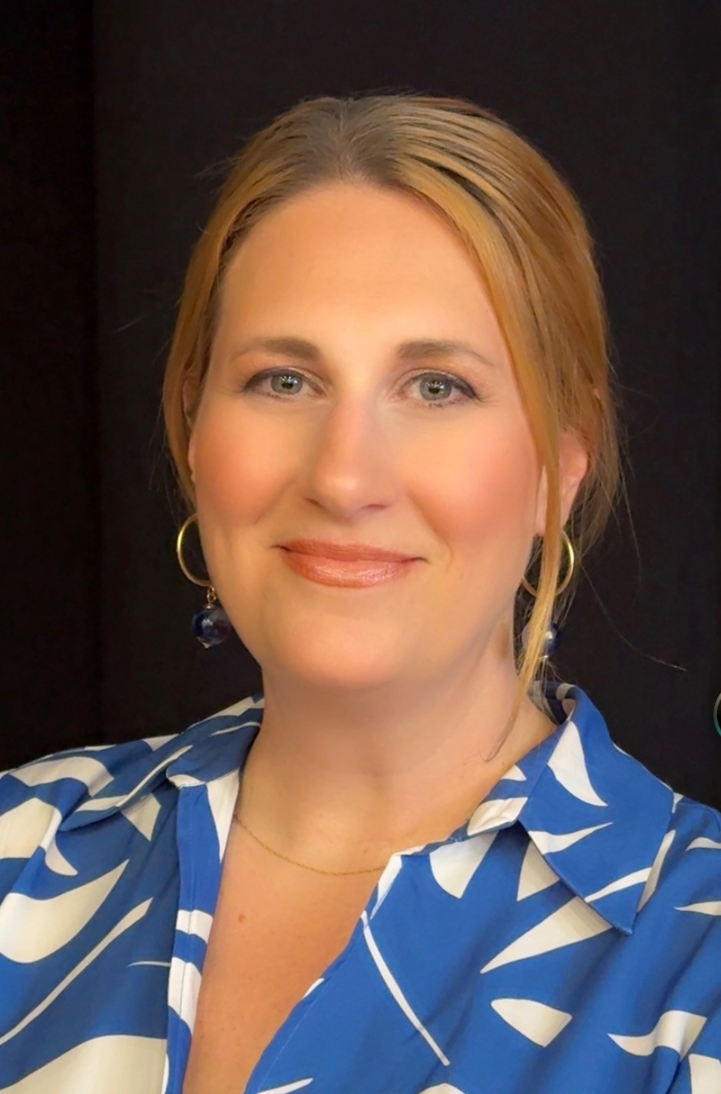

D28- NEW Deputy Superintendent
Re-Introducing Deputy Superintendent Angela Teutschman
Dedicated NYCPS educator for over 25 years with a deep-rooted history in District 28.
Proven Leadership: Principal of J.H.S. 217 (Robert A. Van Wyck) and P.S. 175 (The Lynn Gross Discovery School)
Expertise: A recognized Gray Fellow through Hunter College, specializing in safe, inclusive, and rigorous learning environments. A Recognized Model Principal through the Lighthouse Collaborative, specializing in Career Connected Learning.
Vision: Committed to fostering equity and excellence for every student in our community through collaborative leadership.
“We are thrilled to have a leader who truly knows and loves the District 28 community lead in collaboration with the GREAT 28!”

Slide 6
Summer Rising- Key Dates and Announcements
.
• July 1, 2026 – Summer Rising begins for K–8 students
• July 3, 2026 – Summer Rising closed in observance of Independence Day
• August 7, 2026 – Summer Rising program ends for 6-8
• August 14, 2026 – Summer Rising program ends for K-5
• August 12, 2025 – Summer Rising ends for ESY students
All of our Summer Rising sites are staffed for Principals-in-Charge and Site Supervisors and we are actively staffing for instructional positions.

Slide 7
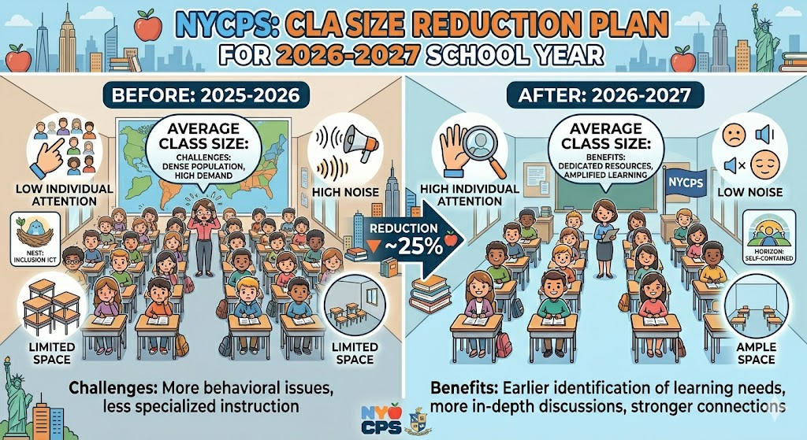
Small Class Size
We are currently awaiting further guidance and direction from Central about the release of funds and the approval status of the submitted applications for the 2026 – 2027 School Year.
.

Slide 8
D28 Attendance Update:
D28 Attendance: - ALL Metrics tracking BETTER than Citywide.
District 28 continues to show strong attendance outcomes compared to the city overall. Year‑to‑date attendance in D28 stands at 91.3%, exceeding the citywide average of 89.7%, while our chronic absenteeism rate is lower at 30.2%, compared to 32.4% citywide. These results reflect focused districtwide efforts, including MTSS‑based tiering to target attendance support, continued professional learning to strengthen school attendance teams, partnerships and incentive‑based programs that encourage positive attendance, and consistent messaging to families about the importance of being in school every day.

Slide 9

NYCPS Guidance on Artificial Intelligence (Draft)
NYCPS has shared updated guidance on AI use, including the following:
District and Principal Mandatory information sessions
AI supports learning, not teaching.
People always come first.
Student data is protected.
Only approved tools may be used. Humans stay in charge.
Educators review all AI use. Clear limits exist.
AI is never used for grades or discipline.
Families have a voice. Questions and feedback are welcome.

Slide 10
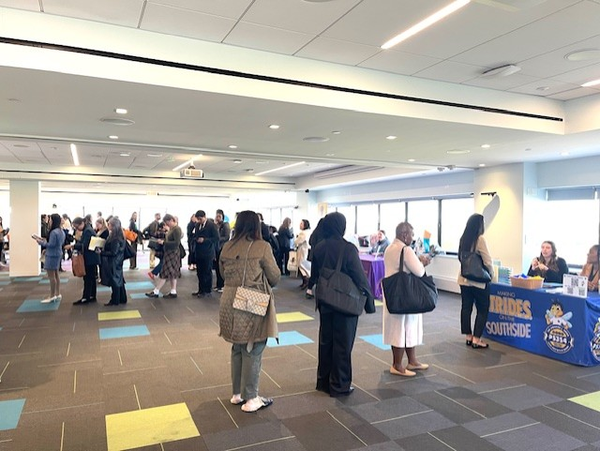
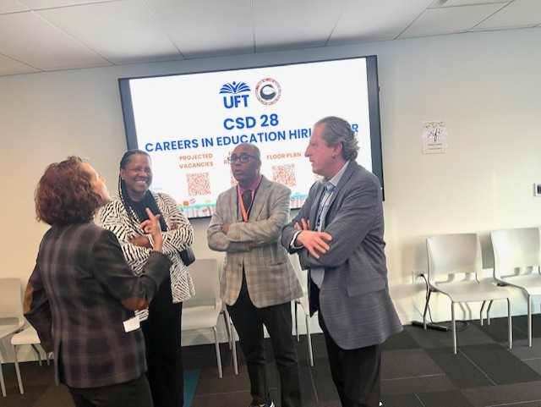
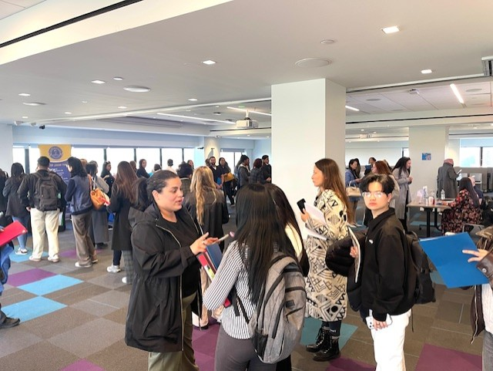
D-28 Hiring Fair:
CSD 28, in partnership with the UFT, hosted a successful Careers in Education Hiring Fair at the Queens UFT.
The event connected multiple schools with candidates for Pre-K–8 roles across the district.
* Over 400 applicants attended, reflecting strong interest in joining D28.
* The fair strengthened the district’s recruitment pipeline, especially in high-need areas.

Slide 11

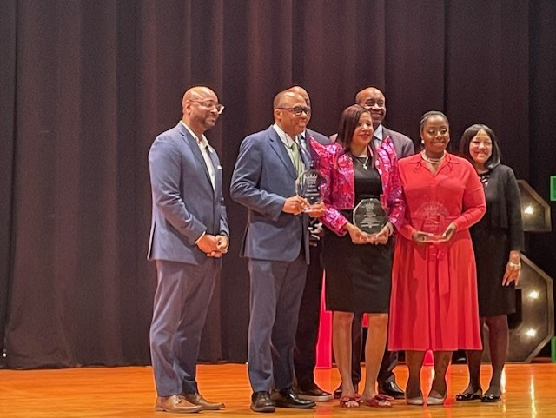
MBK & MSK Queens Symposium:
District 28 continues to proudly strengthen its commitment to My Brother’s Keeper and My Sister’s Keeper, with high‑impact high school partnerships, including our collaboration with Dr. Harper Richardson of Channel View for Research continuing to flourish.
We are proud to recognize the dedication and leadership of Dr. Keturah Hardy and Dr. Josephine Van‑Ess, alongside the ongoing work of my office, as we continue to uplift students and advance this important initiative across our community.

Slide 12
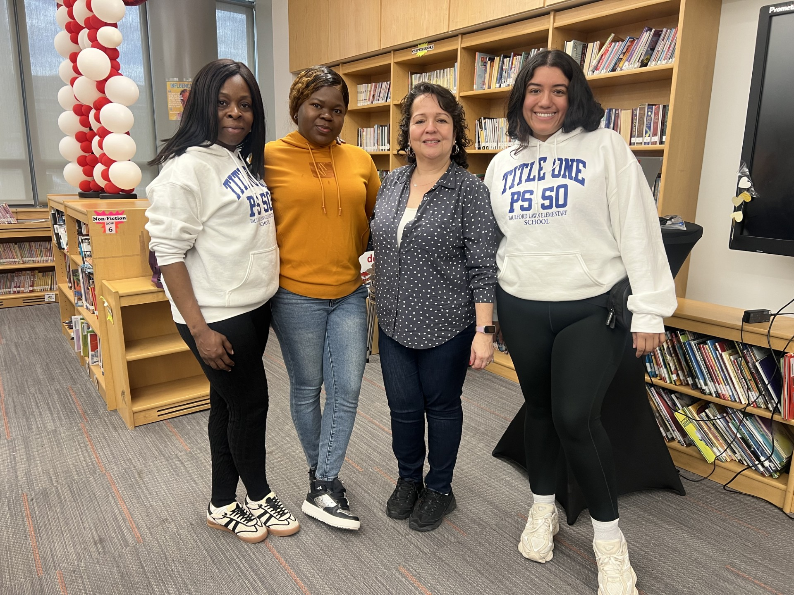
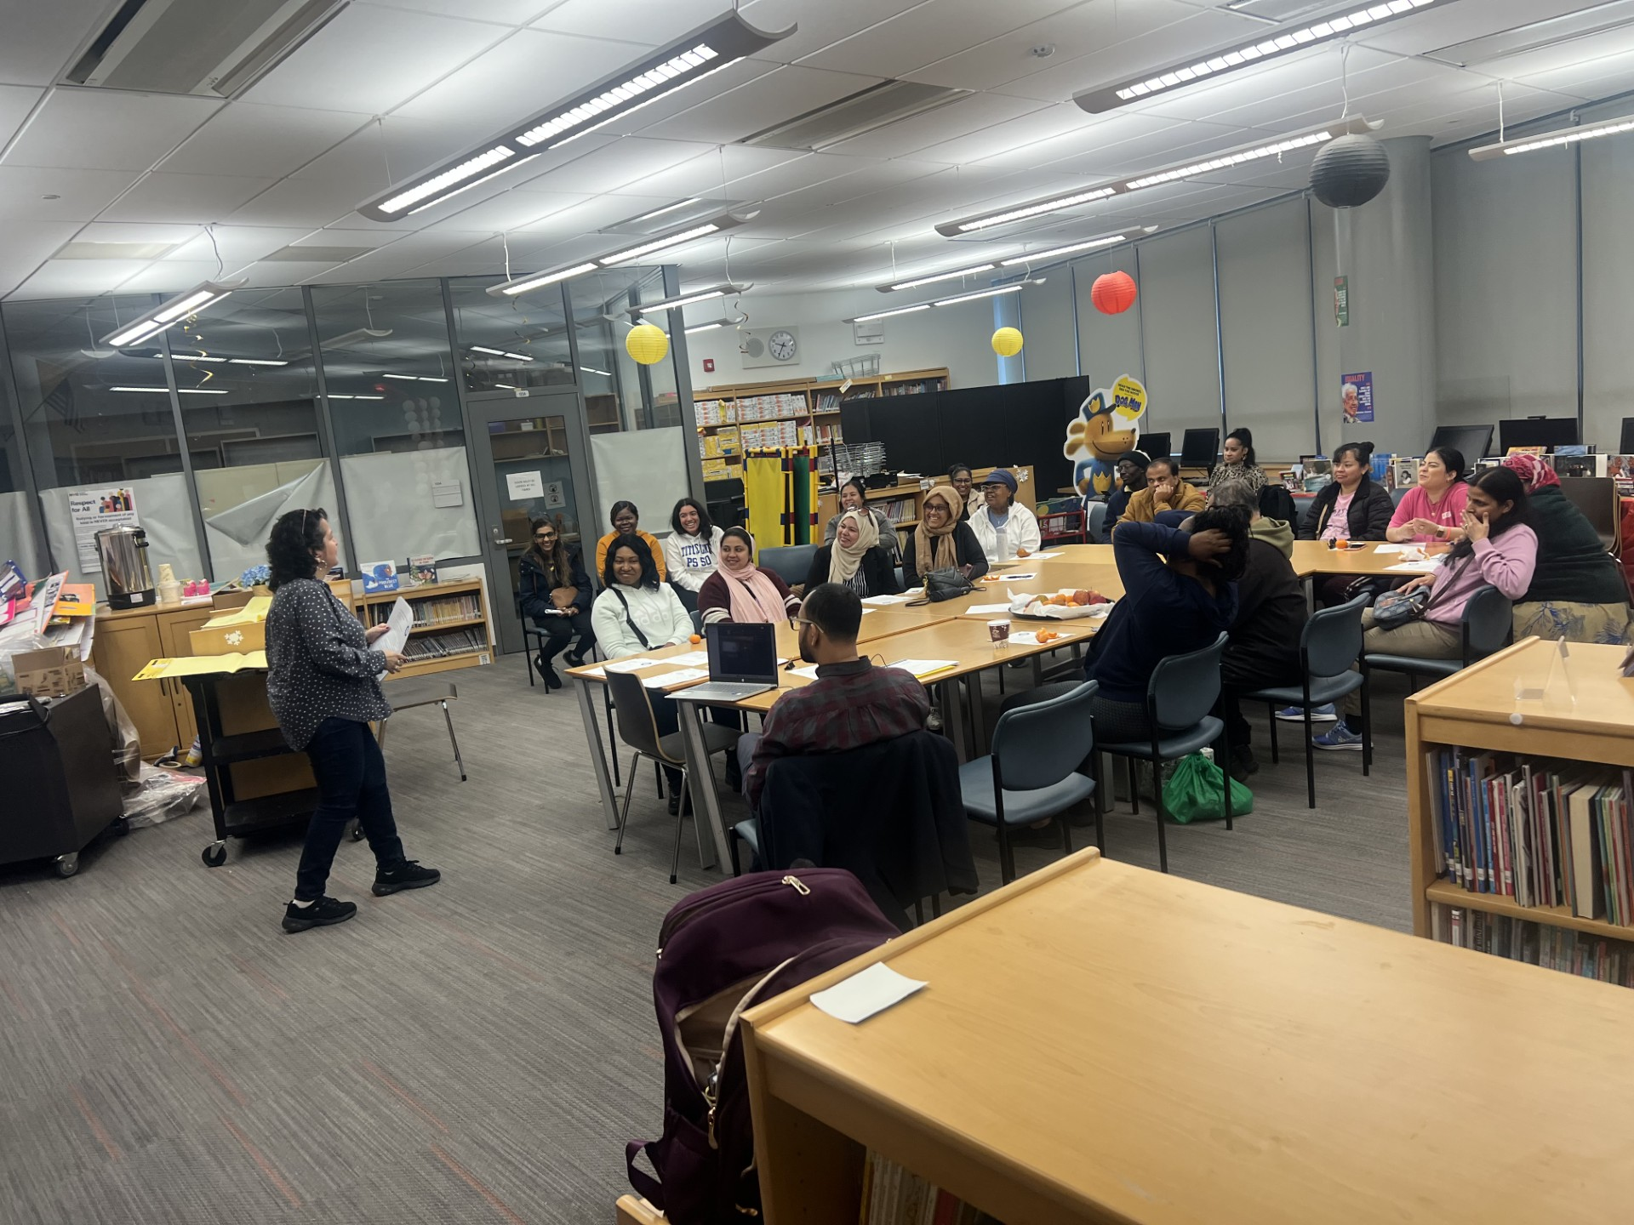
Family Wellness Matters at PS 50
Our very own Sonia Rueda, Family Leadership Coordinator, who is also a licensed Social Worker, was invited by the PS 50 Title I PAC to conduct a mental health workshop on April 1, 2026, titled Family Wellness Matters. Supporting Mental Health at Home and School. Topics included building healthy family relationships, supporting children’s mental health, and self-care tips for parents and caregivers. The hybrid session was well attended and positively received by participants.

Slide 13

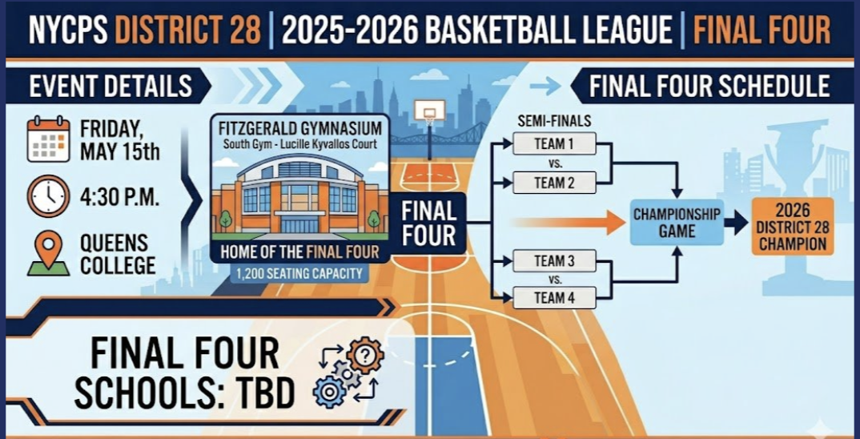
D28 Intradistrict Basketball League
Thank you to Principal Sforza and our dedicated coaches and principals for their commitment to creating this rich and engaging experience for our students.

Slide 14

Congratulations PS 174!
Shoutout to PS 174Q for having Grade 3 students selected for the Food Friends national publication, highlighting their creativity and talent.
The school’s artwork will be featured in a full-color book celebrating student artists across the country, releasing August 31, 2026.
A special congratulations to the young artists from Ms. Zidel’s class—an outstanding achievement for the entire PS 174Q community.

Slide 15
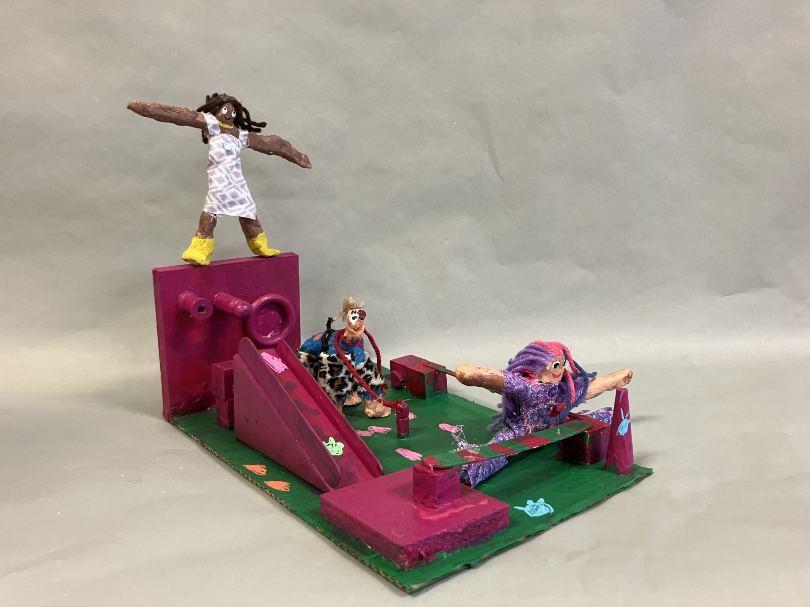

Congratulations PS 175!
Congratulations to P.S. 175Q students and their art teacher for being named P.S. Art 2026 winners.
This honor celebrates the creativity and collaboration of our talented young artists.
We look forward to celebrating their work at the Metropolitan Museum of Art this June.

